Slide 1


PLANT DISEASE PREDICTION & CLASSIFICATION
NAME OF THE SUPERVISOR |  | PROJECT MEMBERS
INTERNAL GUIDE:
Dr.S.Veeramalai M.E,Ph.D
Professor,
Dept. of Computer Science & Engineering
HEAD OF THE DEPARTMENT:
Dr. S. PAVITHRA, M.E., Ph.D.,
Associate Professor,
Dept. of Computer Science & Engineering
DEPARTMENT OF COMPUTER SCIENCE
& ENGINEERING
1. Venkatachalam (210419104182)
2. Sai Balaji N (210419104140)
CHENNAI INSTITUTE OF TECHNOLOGY, CHENNAI-600069
21-06-2022
Department of CSE - CS 8611 Project Work
1

Slide 2
Agenda
Abstract
Objective
Introduction
Literature Survey
Existing System
Proposed System
System Design
Methodology
Results
Conclusion
References
21-06-2022
Department of CSE - CS 8611 Project Work
2

Slide 3
1. Abstract
Plant diseases are a major threat to food security, but their rapid identification remains difficult in many parts of the world due to the lack of the necessary infrastructure. Agriculture provides food to all the human beings even in case of rapid increase in the population. It is recommended to predict the plant diseases at their early stage in the field of agriculture is essential to cater the food to the overall population. But it unfortunate to predict the diseases at the early stage of the crops. The idea behind the paper is to bring awareness amongst the farmers about the cutting-edge technologies to reduces diseases in plant leaf.
The combination of increasing global smartphone penetration and recent advances in computer vision made possible by deep learning has paved the way for smartphone-assisted disease diagnosis.
21-06-2022
Department of CSE - CS 8611 Project Work
3

Slide 4
2. Objective​
To enhance the given input image by Image acquisition and Image preprocessing.
Identify the affected part through texture analysis and Segmentation.
Classify the healthy and affected leaf part by feature extraction and classification.
Train the model by using testing data for accurate result.
21-06-2022
Department of CSE - CS 8611 Project Work
4

Slide 5
3. Introduction
Modern technologies have given human society the ability to produce enough food to meet the demand of more than 7 billion people. However, food security remains threatened by a number of factors including climate change, the decline in pollinators, plant diseases and others. Plant diseases are not only a threat to food security at the global scale, but can also have disastrous consequences for smallholder farmers whose livelihoods depend on healthy crops.
21-06-2022
Department of CSE - CS 8611 Project Work
5

Slide 6
4. Literature Survey
Yashpal Sen, Chandra Shekar Mithlesh, Dr. Vivek Baghel [1] describes an approach for disease detection of crop for economic growth of rural area. This paper discussed about an automated system for identifying and classifying different diseases of the contaminated plants is an emerging research area in precision agriculture.
K. Elangoran, S. Nalini [2] presented a concept of plant disease classification using image segmentation and SVM techniques. This paper describes an image processing technique that identifies the visual symptoms of plant diseases using an analysis of colored images, work of software program that recognizes the color and shape of the leaf image. .
21-06-2022
Department of CSE - CS 8611 Project Work
6

Slide 7
5.1 Existing System
5.2 Drawbacks in Existing System
Leaf shape description is that the key downside in leaf identification. Up to now, several form options are extracted to explain the leaf form
A number of the classification techniques used are:
Fuzzy logic
Principal component Analysis
k-Nearest Neighbors Classifier
There is no correct application to classify the leaf once capturing its image and identifying its attributes
In plant leaf classification leaf is classed supported its completely different morphological options
21-06-2022
Department of CSE - CS 8611 Project Work
7

Slide 8
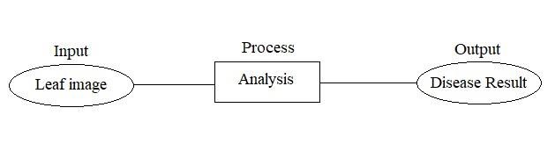
6. Proposed System
The main purpose of proposed system is to detect the diseases of plant leaves by using feature extraction methods where features such as shape, color, and texture are taken into consideration. Convolutional neural network (CNN), a machine learning technique is used in classifying the plant leaves into healthy or diseased and if it is a diseased plant leaf, CNN will give the name of that particular disease. Suggesting remedies for particular disease is made which will help in growing healthy plants and improve the productivity.
21-06-2022
Department of CSE - CS 8611 Project Work
8

Slide 9
6.1 Advantages of Proposed System
6.2 Scope
The detection accuracy is enhanced with proposed algorithm.
Proposed method is fully automatic while existing methods require user input to select the best segmentation of input image.
It also provides environment friendly recovery measures of the identified disease.
The scope is to create a model that detects and classifies the infected plant leaves using machine learning and deep learning.
21-06-2022
Department of CSE - CS 8611 Project Work
9

Slide 10
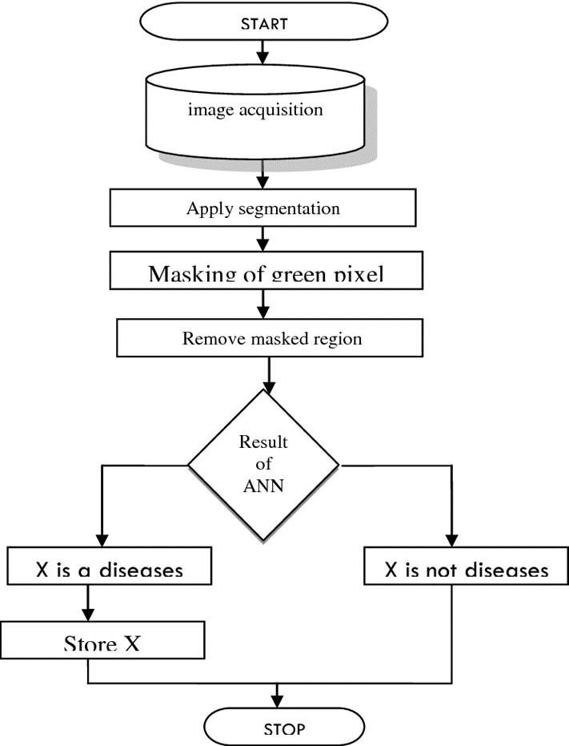
7. System Design
21-06-2022
Department of CSE - CS 8611 Project Work
10

Slide 11
8. Methodology
Algorithm written below illustrated the step by step approach for the proposed image recognition and segmentation processes:
Image acquisition is the very first step that requires capturing an image with the help of a digital camera.
Pre-processing of input image to improve the quality of image and to remove the undesired distortion from the image. Clipping of the leaf image is performed to get the interested image region and then image smoothing is done using the smoothing filter. To increase the contrast Image enhancement is also done.
Mostly green colored pixels, in this step, are masked. In this, we computed a threshold value that is used for these pixels. Then in the following way mostly green pixels are masked: if pixel intensity of the green component is less than the precomputed threshold value, then zero value is assigned to the red, green and blue components of the this pixel.
In the infected clusters, inside the boundaries, remove the masked cells.
Obtain the useful segments to classify the leaf diseases.
21-06-2022
Department of CSE - CS 8611 Project Work
11

Slide 12
9. Requirements
Technology Used:
Tkinter
Sklearn
OpenCV
Tensorflow
Hardware Tool:
Processor- IntelCore
Operating System- Windows 10 (64-bit)
RAM- 8 GB
Software Tool:
Anaconda
Jupyter notebook
21-06-2022
Department of CSE - CS 8611 Project Work
12

Slide 13
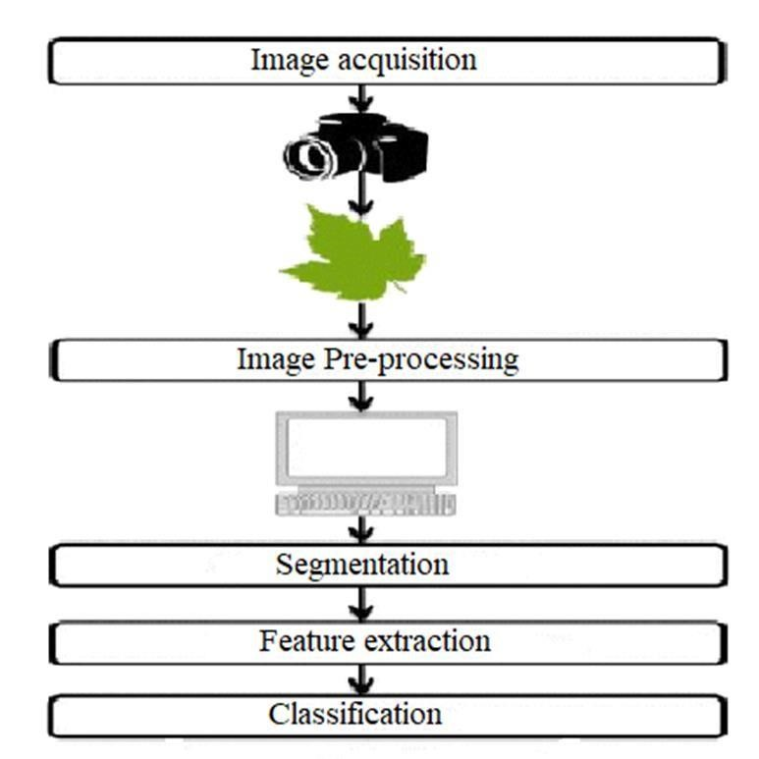
10. Implementation
21-06-2022
Department of CSE - CS 8611 Project Work
13

Slide 14
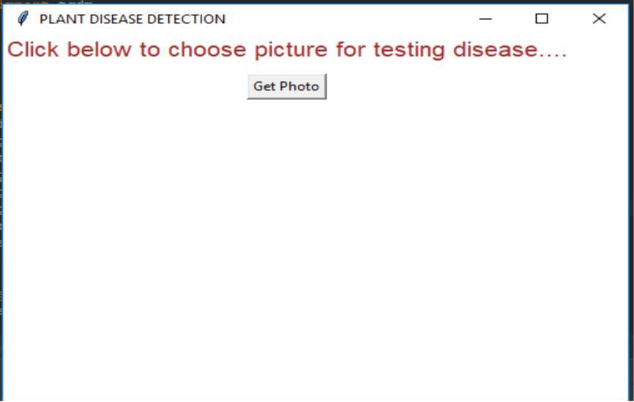
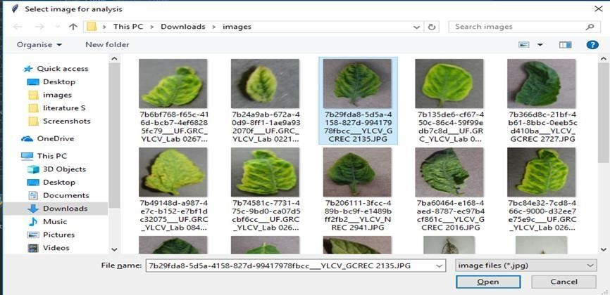
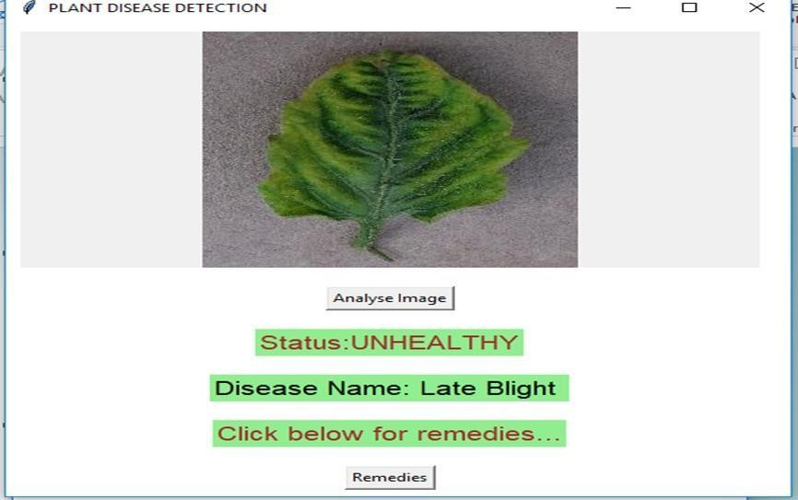
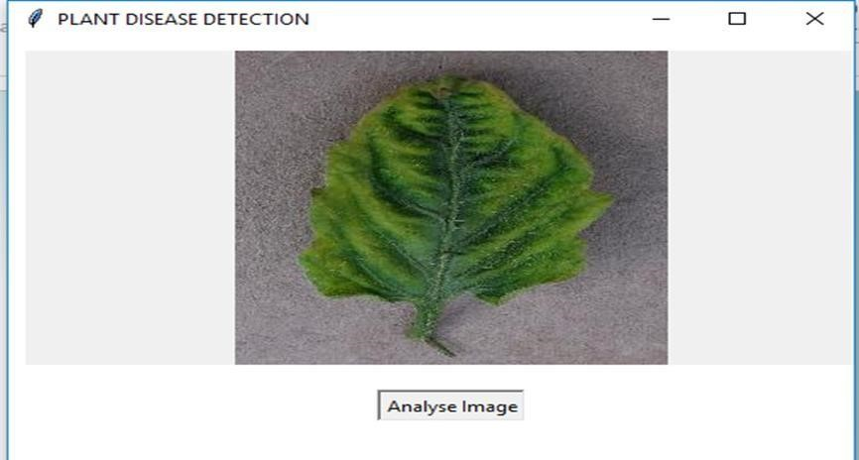
11. Result
21-06-2022
Department of CSE - CS 8611 Project Work
14

Slide 15
12.1 CONCLUSION
12.2 Future Scope:
To improve recognition rate of final classification process hybrid algorithms like Artificial Neural Network, Bayes classifier, Fuzzy Logic can also be used.
Mobile application can be developed which is handy and easy to use.
An extension of this work will focus on automatically estimating the severity of the detected disease
There are number of ways by which we can detect disease of plants and suggest remedies for them. Each has some pros as well as limitations.
On one hand visual analysis is least expensive and simple method, it is not as efficient and reliable. Image processing is a technique which is most spoken for very high accuracy and least time consumption are major advantages offered.
Recognizing the disease accurately and efficiently is mainly the purpose of the proposed approach.
21-06-2022
Department of CSE - CS 8611 Project Work
15

Slide 16
13. References
A survey on crop disease detection using image processing technique for economic growth of rural area. Yashpal Sen1, Chandra Shekhar Mithlesh2, Dr. Vivek Baghel3
K. Elangoran, S. Nalini, 2011 “Detection and classification of leaf diseases using K- means-based segmentation and neural-networks-based classification.” Inform Technol. J., 10: 267-275. DOI: 10.3923/itj.2011.267.275.
21-06-2022
Department of CSE - CS 8611 Project Work
16

Slide 17
THANK YOU
21-0-2022
Department of CSE - CS 8611 Project Work
17

